Slide 1
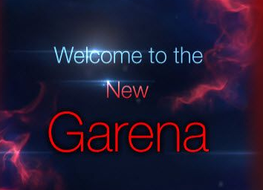
caaamillejc
>
Remember Password
Login Now
Register A New Account
Forgot Password?
English
>

Slide 2


Garena
caaamillejc
Logout
Philippines v
Home v Games v Platforms v Support Account Career

Slide 3




Garena
Home v Games v Platforms v Support Account Career
League of Legends
Arena of Valor
Free Fire
Play Now
Play Now
Play Now

Slide 4

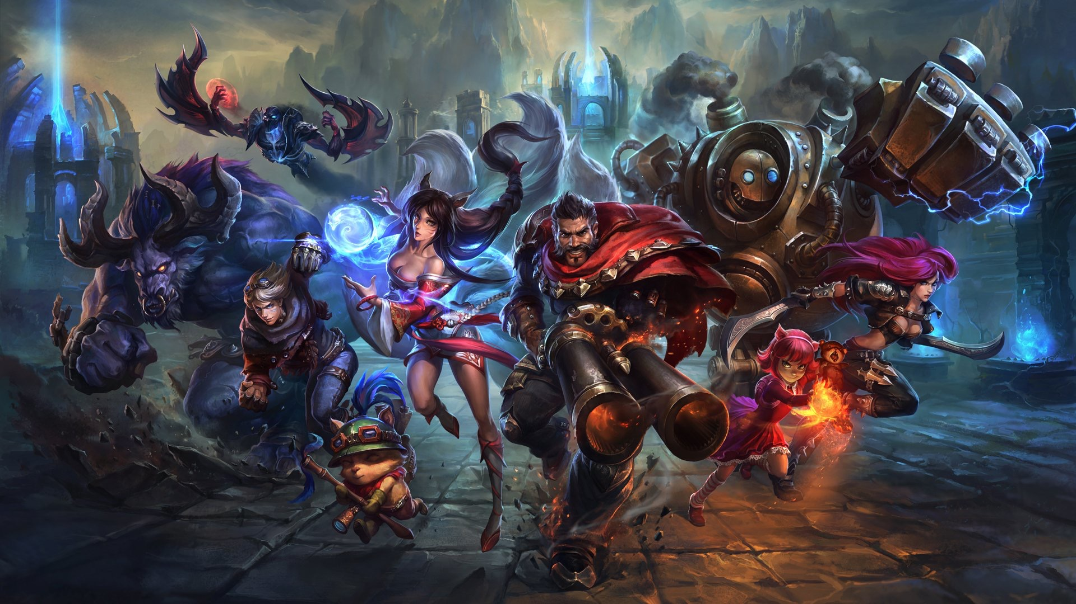


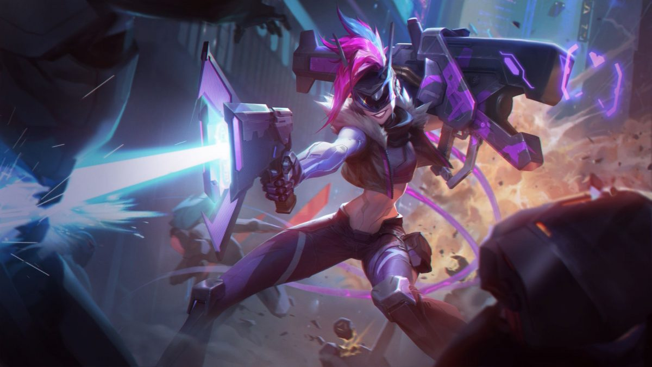
HOME NEWS v GAME INFO UNIVERSE SUPPORT
DOWNLOAD | TOP UP
PLAY LEAGUE OF LEGENDS NOW
Install Garena to Launch League of Legends
DOWNLOAD NOW
PROJECT
CRATE
PROJECT
JINX’S CAPSULE
CONTENT
PROJECT 2019 EVENT GUIDE
SALES
PROJECT: LUCKY CRATE!
EVENTS
PROJECT IRELIA’S CAPSULES!

Slide 5




NEWS ESPORTS HEROES
GAME STRATEGY COMMUNITY
GARENA’S
1ST MOBILE MOBA

Slide 6


HOME NEWS WEAPONS CHARACTERS MAP v MEDIA v EN v |

